Slide 1


What factors influence the apparition of pathologies?
BAJOLAH Arvind
BRFSS 2020
Notes:
Regrouper sur la slide d’intro group members, Introduction/problématique et Customer persona ?

Slide 2

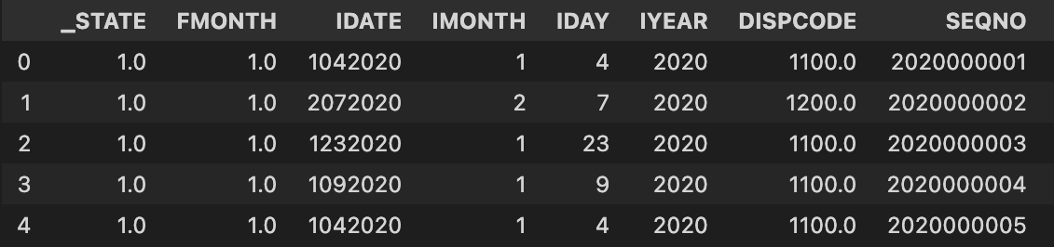
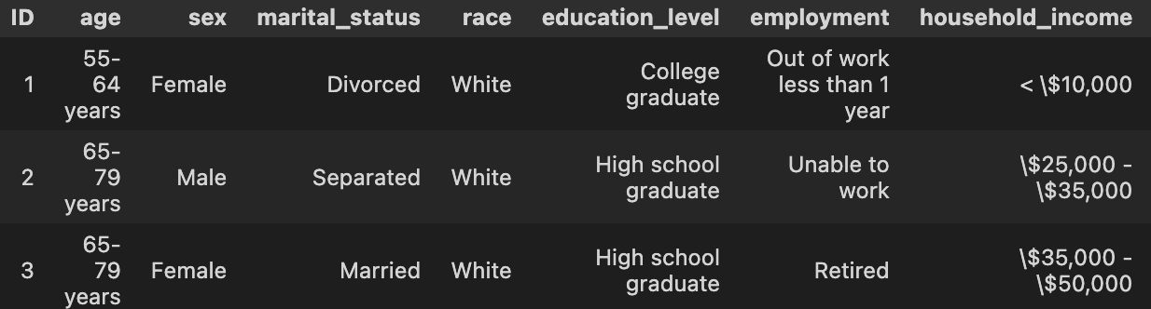
Data cleaning and preparation of the dataset on Python
Before cleaning
401 957 rows
279 columns
After cleaning
245 992 rows (38% of the initial dataset)
44 columns, including 11 variables to explain

Slide 3


Dashboard
Notes:
Regrouper sur la slide d’intro group members, Introduction/problématique et Customer persona ?

Slide 4
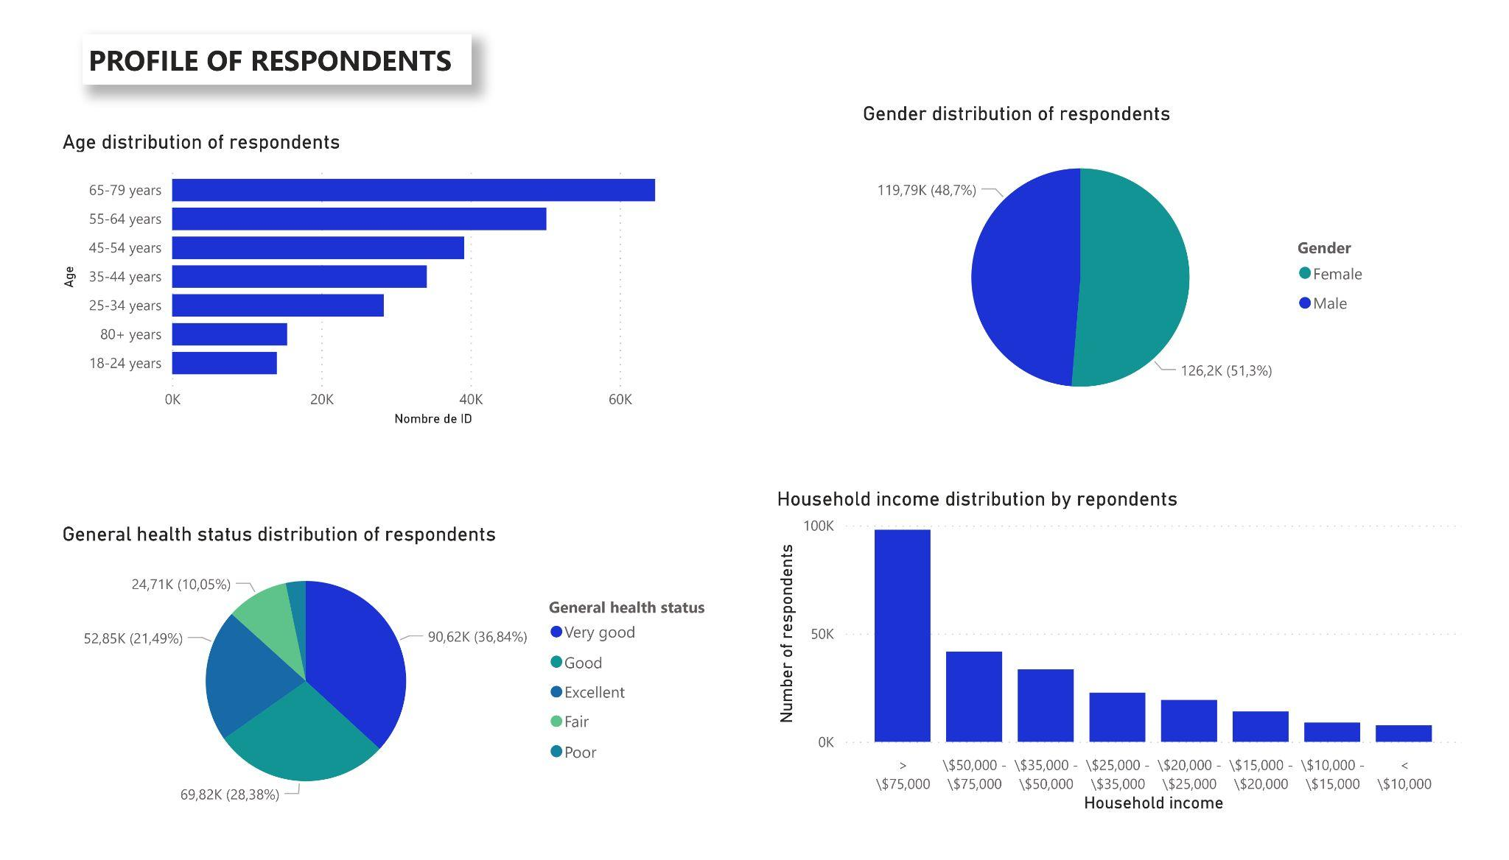
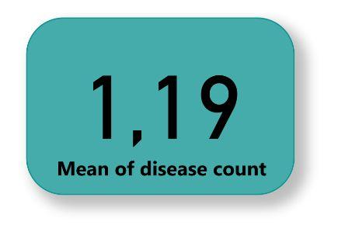
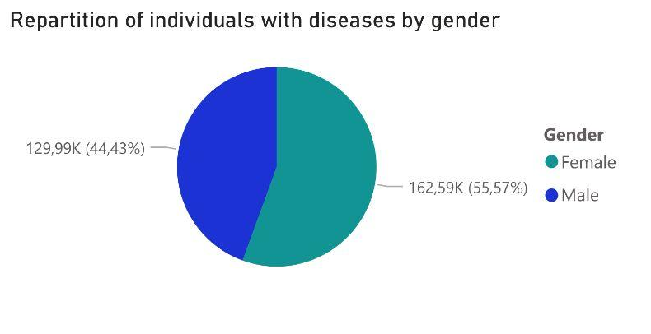
An unbalanced population on some points
Notes:
Lien à rajouter jour-j

Slide 5
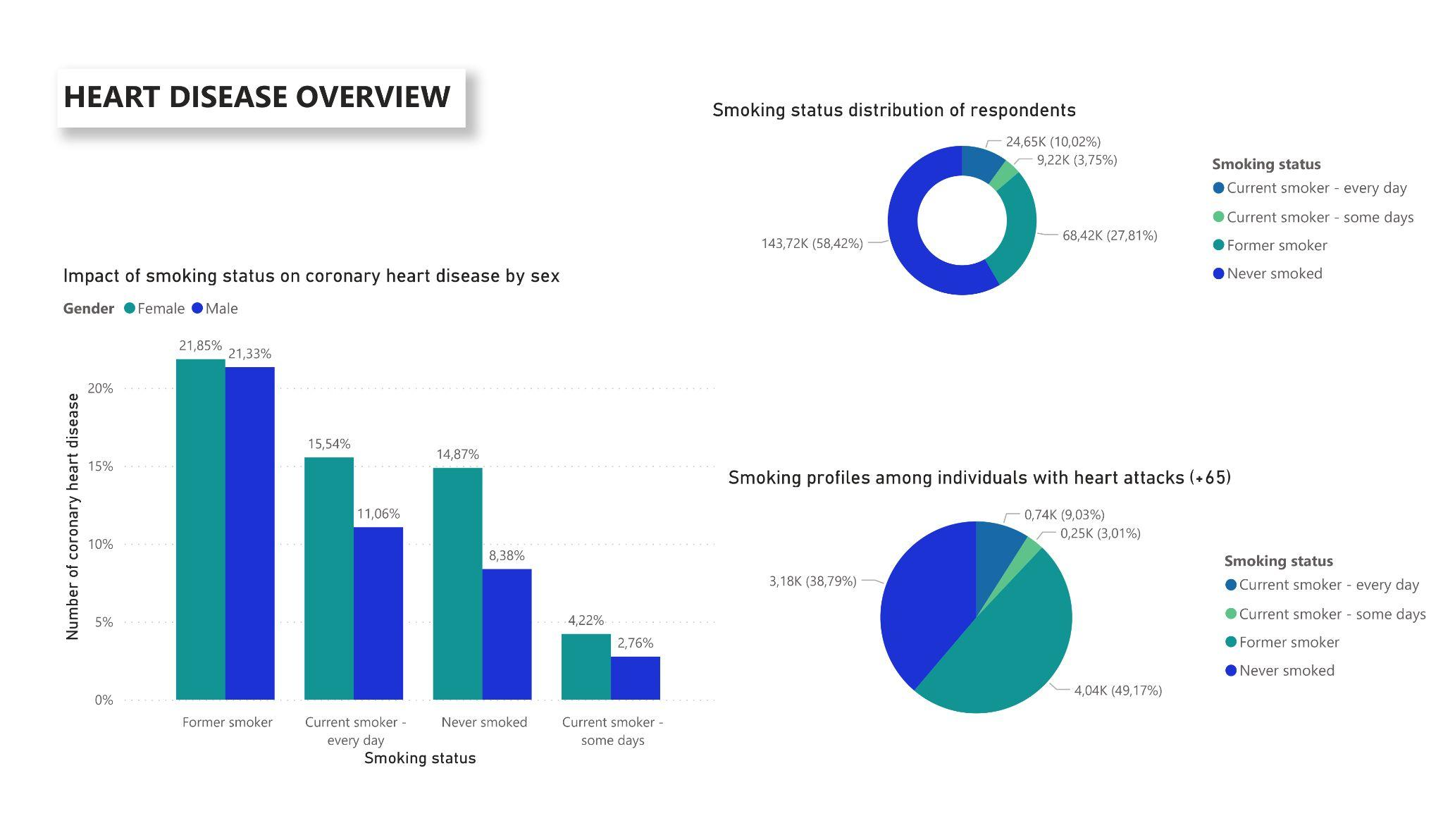
Smoking status : formers smoker are the most affected by disease

Slide 6
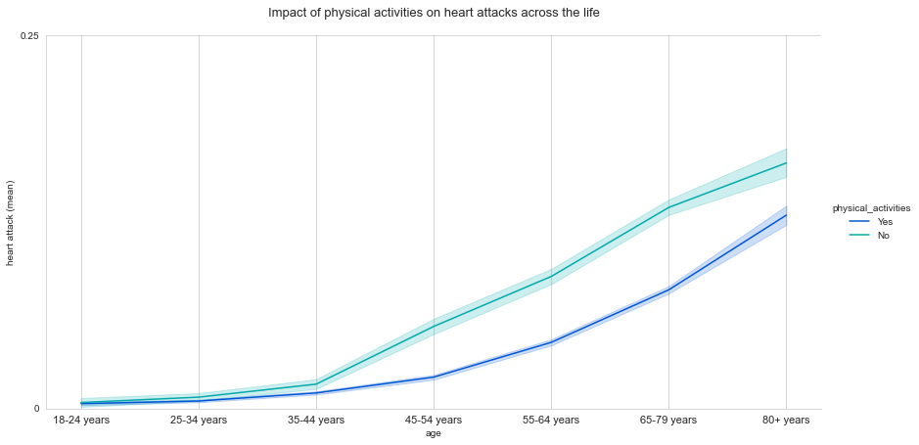
Impact of physical activities on heart attacks across the life

Slide 7
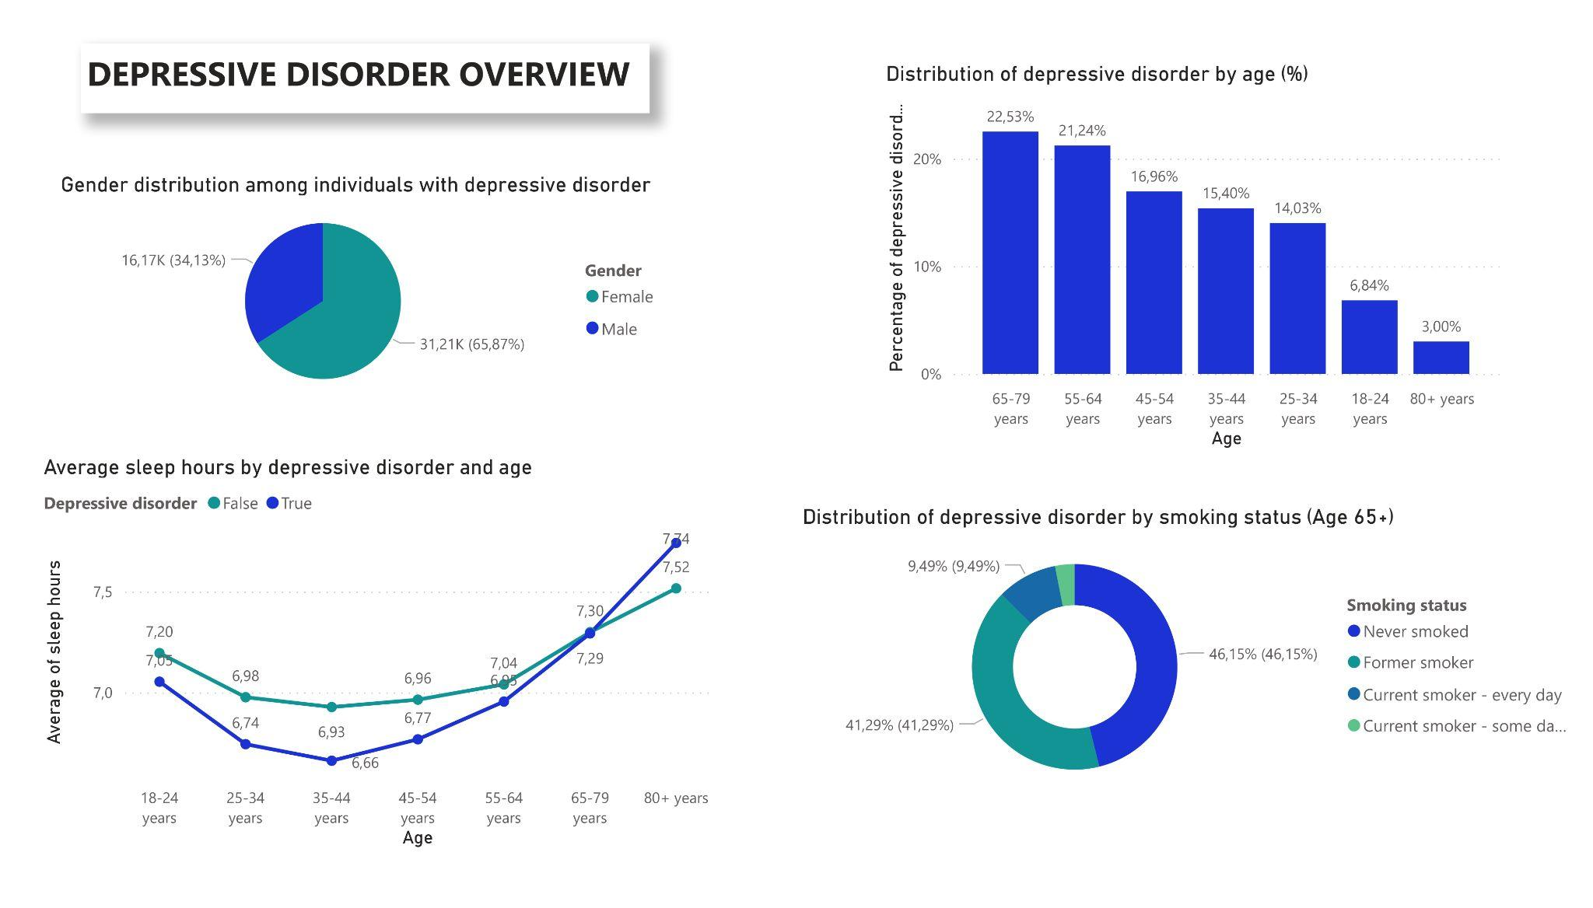
Depressive disorder impacted by demographic factors

Slide 8

To go further…
Notes:
Regrouper sur la slide d’intro group members, Introduction/problématique et Customer persona ?

Slide 9
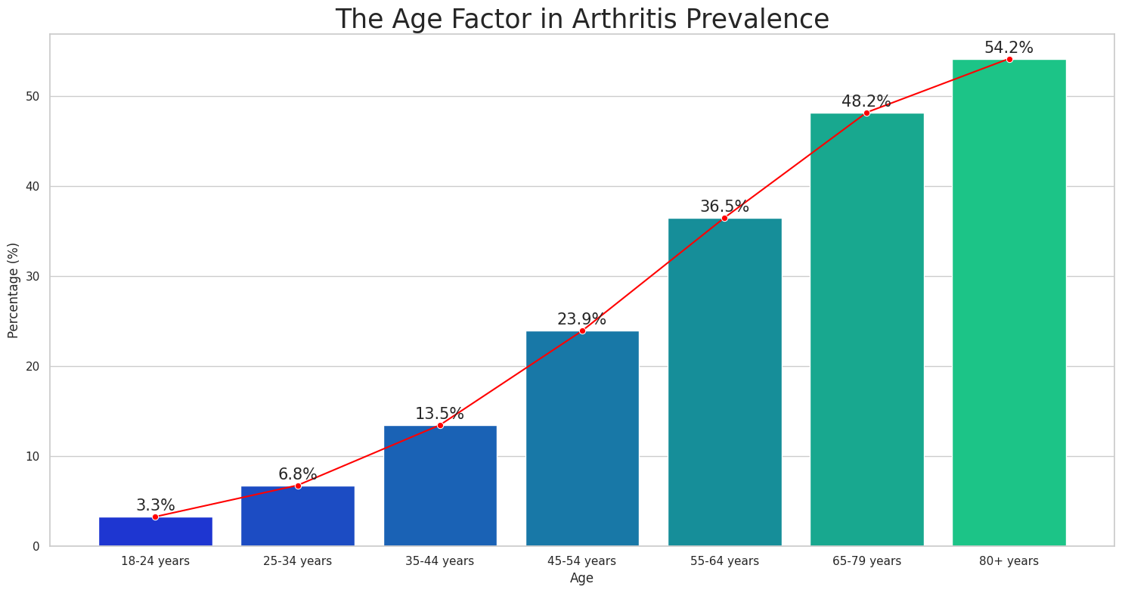
Evolution of arthritis across the life

Slide 10
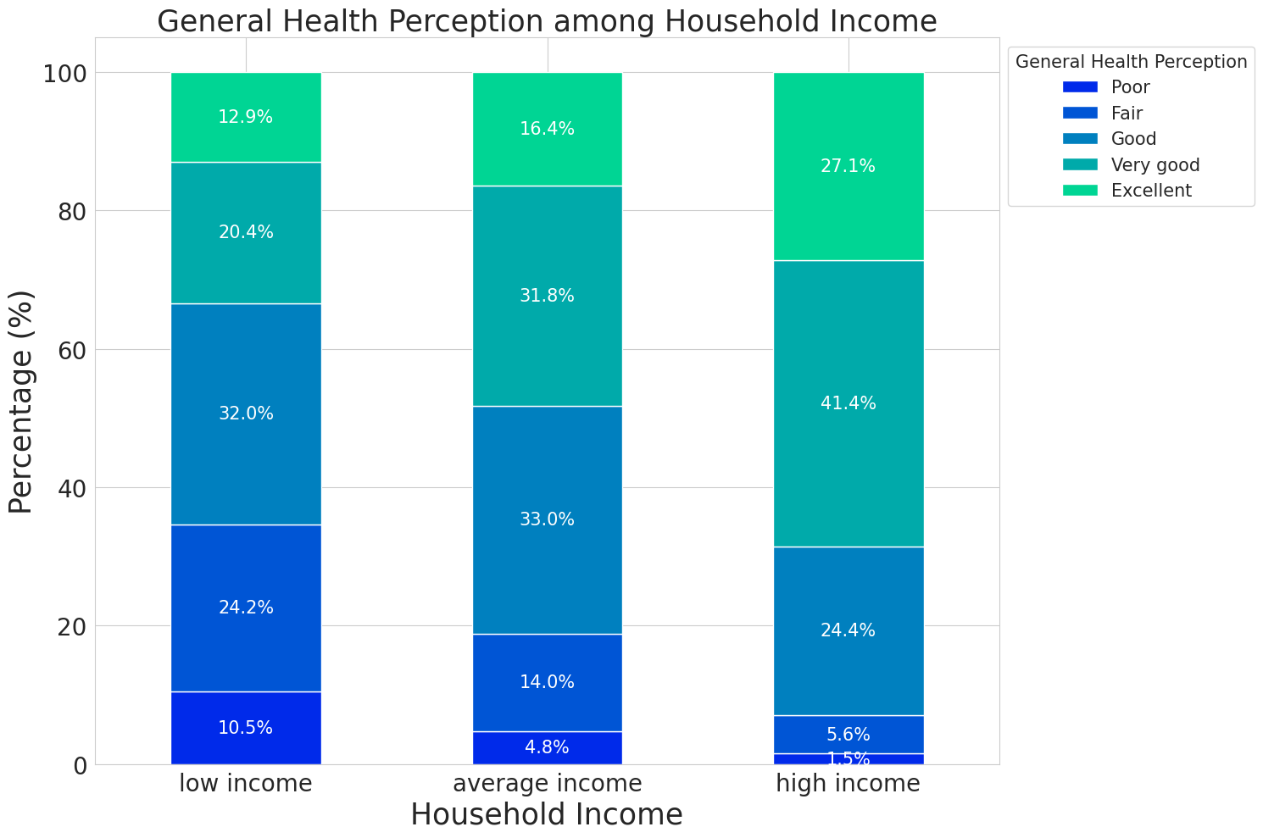
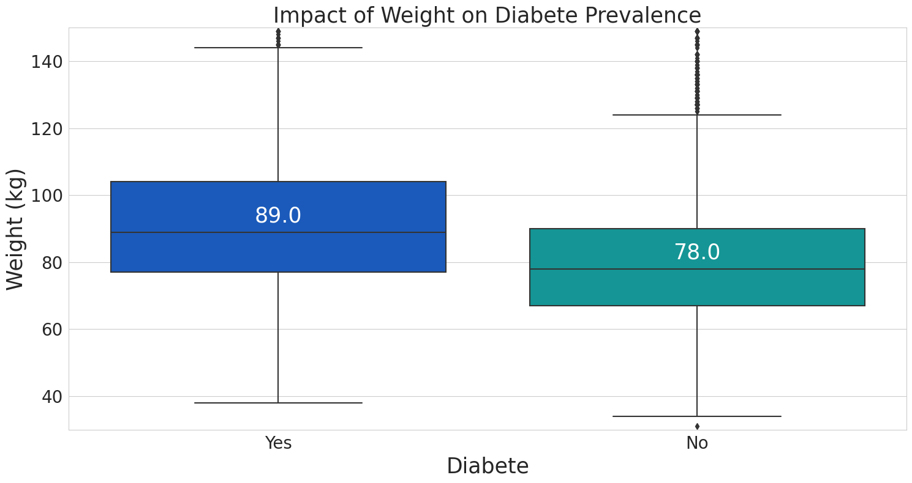
Others factors : household income and weight

Slide 11

Machine learning
Notes:
Regrouper sur la slide d’intro group members, Introduction/problématique et Customer persona ?

Slide 12
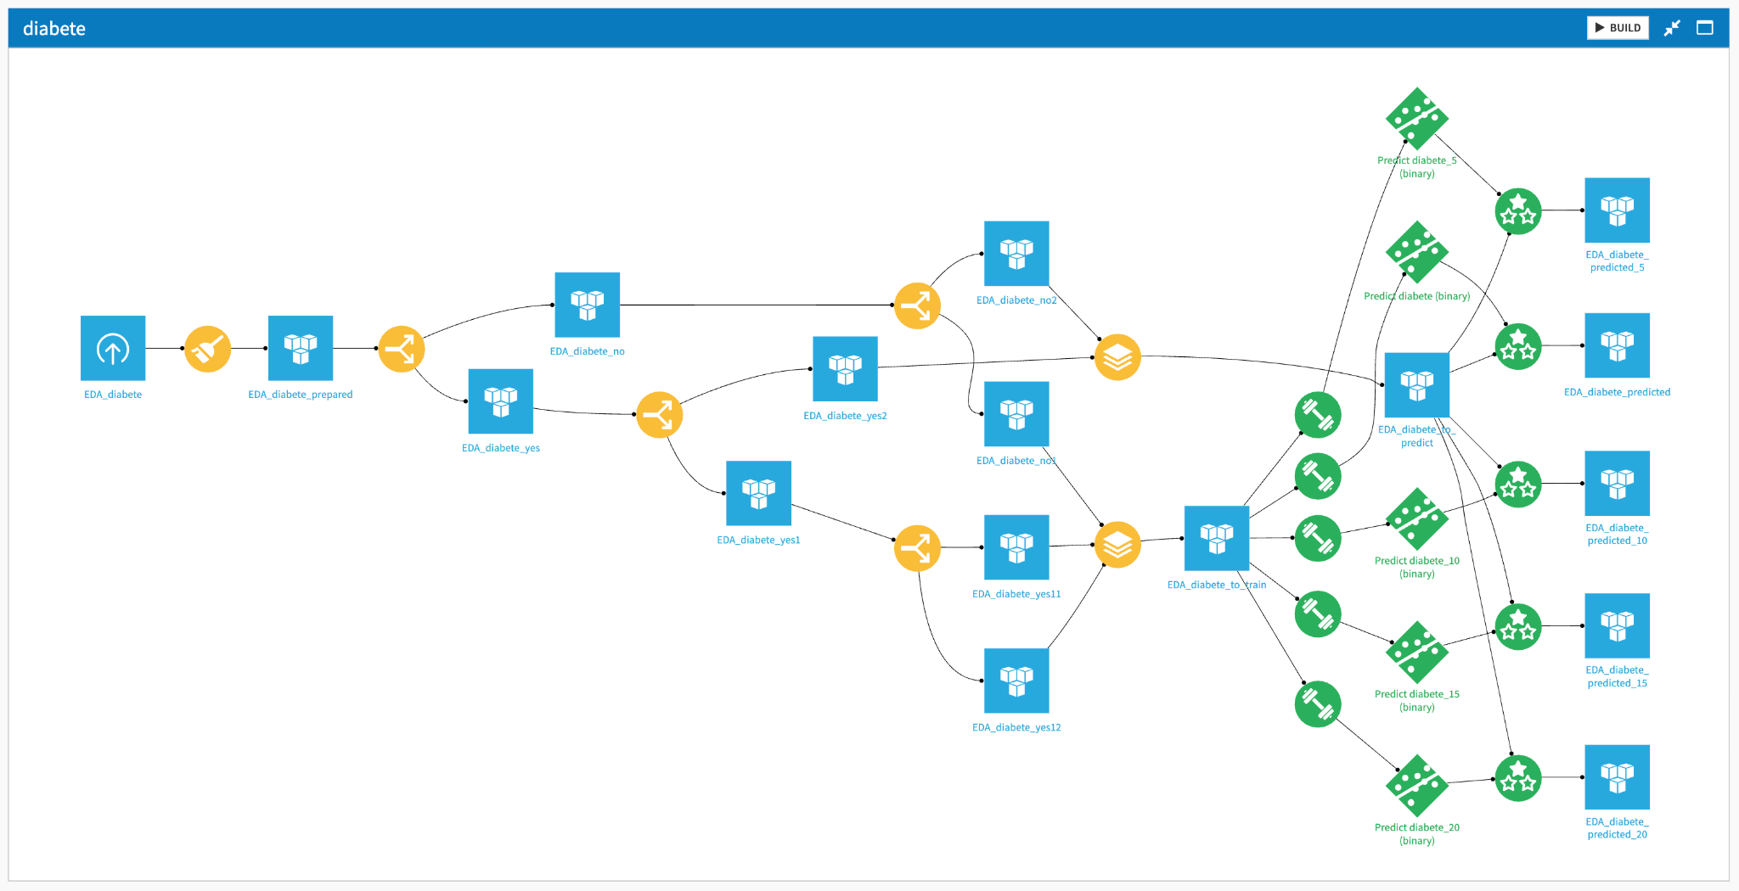
Machine learning
Predicting the Development of Diabetes

Slide 13
Machine learning
Results
We are choosing the F1 score as our metric, a higher F1 score indicates a more effective model, useful for our objective : minimizing the rate of false negatives
Disease | Model | F1 Score | Feature Handling | Number of Records (k) | Predict Score (%)
chronic obstructive pulmonary disease | LightGBM | 80 | TOP 15 | 18 | 76,2
kidney disease | Gradient Boosted Trees | 76 | TOP 15 | 8,8 | 64
diabète | LightGBM | 78 | TOP 20 | 31,6 | 87,8
depressive_disorder | LightGBM | 77 | TOP 15 | 47,2 | 72,5
skin cancer | Gradient Boosted Trees | 75 | TOP 20 | 22,8 | 57,9
asthma | Random forest | 67 | TOP 5 | 32,4 | 73,3
heart attack | Gradient Boosted Trees | 80 | TOP 10 | 12,6 | 79,4
stroke | Gradient Boosted Trees | 77 | TOP 5 | 8,7 | 64,1
arthritis | Logistic Regression | 76 | TOP 15 | 74 | 67,6
all type cancer | Gradient Boosted Trees | 74 | TOP 15 | 22 | 55
coronary heart disease | Logistic Regression | 82 | TOP 10 | 13,6 | 78,7

Slide 14
Conclusion
Notes:
Regrouper sur la slide d’intro group members, Introduction/problématique et Customer persona ?

Slide 15
Conclusion
Models could be more effective with various features (alimentation habits…)
Comparison with 2021’s dataset
Creation of a personalised prediction application for individuals

Slide 16

Any questions ?

